Slide 1
DevOps & Application Lifecycle Management with the Power Platform
Greg Roe
Cloud Solutions Architect – AppDev
gregroe@microsoft.com
425.301.9775

Slide 2

Introductions
Greg Roe
Cloud Solutions Architect - App Dev
App Innovation Team – Microsoft Federal
25 years at Microsoft
Live in Seattle 35 years
University of Michigan – Electrical Engineering
Wife, Daughter (24), 2 dogs (Lab and Corgi)
Hiking, Traveling
Peace Corps
LinkedIn Profile
Cloud Solution Architect Role
Microsoft Investment to large customers
Technical role
Help customer maximize value with their Microsoft investment
Design Reviews, POC, Solution Architecture
Please engage !

Slide 3
Agenda
DevOps and Application Lifecycle Management backgrounder
Power Platform DevOps Principles:
Environment strategies
Solutions
DevOps Tools:
Azure Devops
GitHub Actions
ALM Accelerator – COE Starter Kit
PAC – Power Platform CLI
Demos
Permit Management - working demo of pushing a power app solution from dev to test using Azure DevOps
Contoso Bikes – DevOps using GitHub Actions
Diabetes – Power Canvas App to Azure Machine Learning backend
From Scratch: Create a new Power App then manually Export from Dev and Import to Test
PAC CLI
ALM Accelerator
Exercise and Lab

Slide 4
What is DevOps and ALM: Terminology
ALM Application Lifecycle Management
Streamlining software Development Agile or Waterfall
Best fits Agile
Interative, Repetitive cycles that Accelerate production
ALM with the Microsoft Power Platform
DevOps
What is DevOps? Plan, Develop, Deliver, Operate
Accelerate Agile approach in Software Lifecycle Management
A culture that practices deploying Software faster.
Promotes collaboration between Development and Operations Teams
Automating the Building, Testing, and Deployment process through Continuous Integration and Continuous Delivery (CI/CD) pipelines
Many Tools: Azure Devops, GitHub Actions, Jenkins
Agile
Methodology involving the continuous iteration of development and testing.
Emphasizes interative, incremental, and evolutionary development
Early and continuous delivery of valuable software
Agile Manifesto

Slide 5
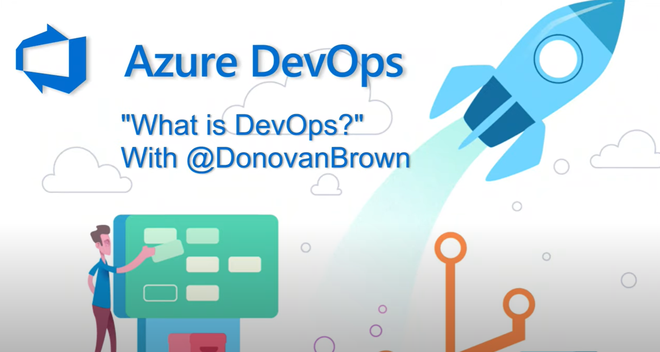

Slide 6
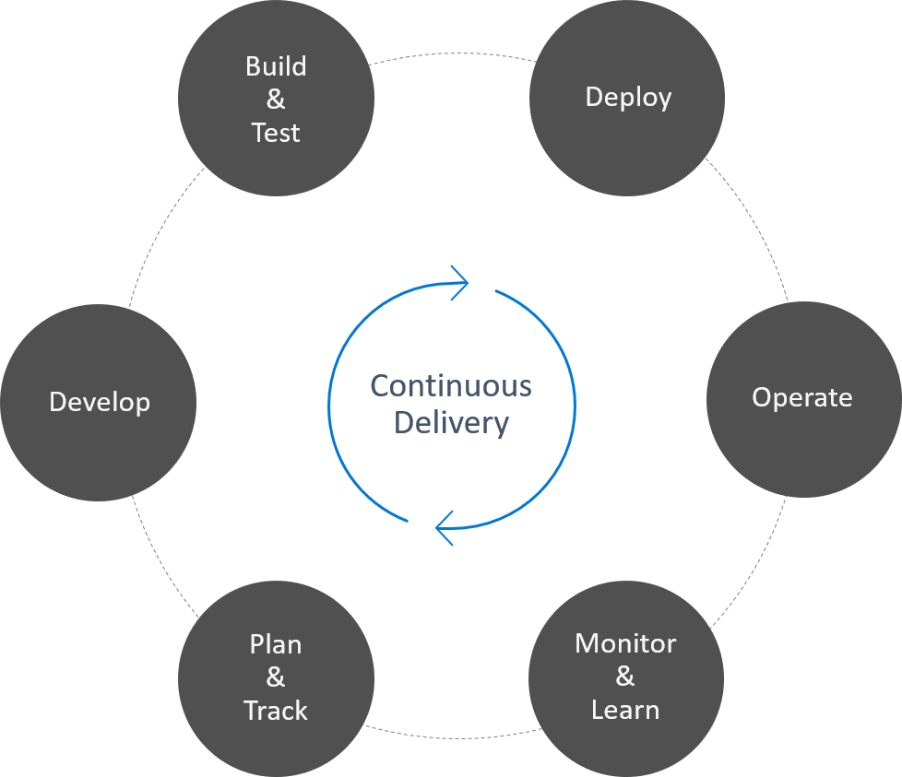
What is DevOps?
People, Process, Products
"DevOps is the union of people, process, and products to enable continuous delivery of value to our end users."
— Donovan Brown
Notes:
DevOps is a software development practice that promotes collaboration between development and operations, resulting in faster and more reliable software delivery. Commonly referred to as a culture, DevOps connects people, process, and technology to deliver continuous value.
Reference DevOps Tutorial | Microsoft Azure
6

Slide 7
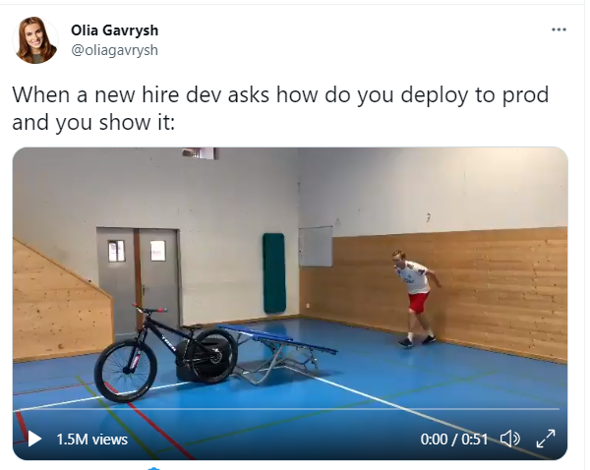

Slide 8

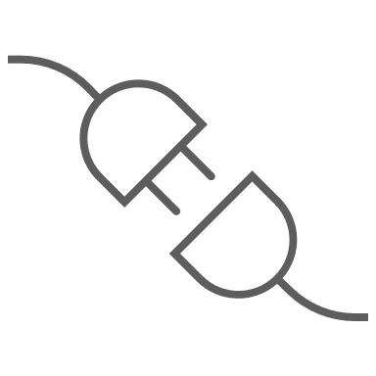

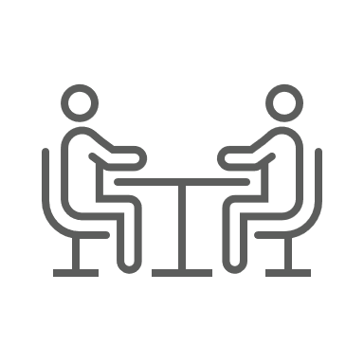
Why is DevOps Needed?
Software development process can be a highly manual process, resulting in a significant number of code errors.
Development and operations teams can often be out of sync, which can slow software delivery and disappoint business stakeholders.
DevOps creates efficiency across all tasks involved in the development, deployment, and maintenance of software.
Connecting development and operations leads to increased visibility, more accurate requirements, improved communication, and faster time to market.
Increasing investment and ROI
Notes:
The philosophy of DevOps is to take end-to-end responsibility across all aspects of the project.
DevOps is really a culture that focuses on creating efficiency for all stakeholders involved in the development, deployment, and maintenance of software.
Versus
Agile is a lean manufacturing process that helps provide a software development production framework.
8

Slide 9
Power Platform vision for ALM
Quick Start: Enable app builders to get set up with an environment with the latest build and connected to source control and make a change quickly
Build: Simplify tooling, consolidate portals and speed up inner loop
Deploy: Enable an automated repeatable (predictable) deployment methodology
Manage: Invest in additional environment management capabilities to offer more flexibility for app builders to use and dispose preconfigured environments as needed
Monitor: Application telemetry and feedback loop by design
Notes:
Solution Architects should understand the vision and journey Microsoft is on to shape how ALM is done for Power Platform projects. As this journey evolves, Solution Architects should continue to shape their own plans to leverage the capabilities provided by the platform and tools.
Inner Loop – the iterative process that an app builder performs when creating an app and its components and local testing before sharing with the broader team

Slide 10
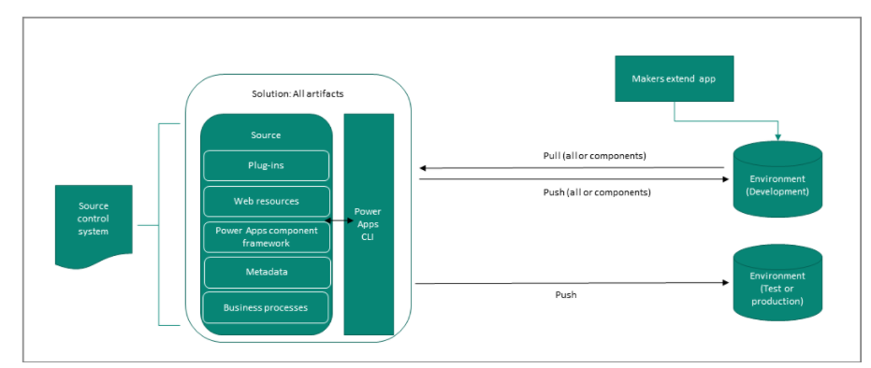
ALM basics with Microsoft Power Platform

Slide 11
Key Solution Architect ALM considerations
Environment Strategy – How many, what’s their purpose
Source Control – Where will the master copy of the solutions and code live
DevOps – What is the workflow for app builders and how/who will promote the app on its journey from dev to production
Deployment Configuration – How to configure each environment and what can be done to make this easier
Notes:
This includes helping the organization put in place proper governance for the solution

Slide 12
DEMO: Power Apps DevOps CICD with Azure DevOps Pipelines
“Building Permit Management Solution”
Canvas App - Inspectors field app
Model Driven App - Back Office permit management
Portal App - Public Facing app to request a permit

Slide 13
The Problem with App Modernization:
Legacy apps are expensive and difficult to update
App Dev framework choices are vast and complicated. It’s hard to find skilled developers
It’s hard(and expensive) to develop, test, deploy, and maintain high quality business software
It’s hard (and expensive) to maintain servers and services to run apps.
It’s hard to deliver new business value features quickly
Power Platform Value Proposition:
Low or No Code mean dev done by citizen developers/power users - does not need highly skilled pro developers
SaaS solution- No costly virtual or physical Servers or Services to manage
No complicated multi-tier or distributed application architecture to design,deploy, and support.
Easily connect to a myriad of Cloud and On prem data sources – hundreds of data connectors.
Easy and fast to wire up Business applications and processes

Slide 14
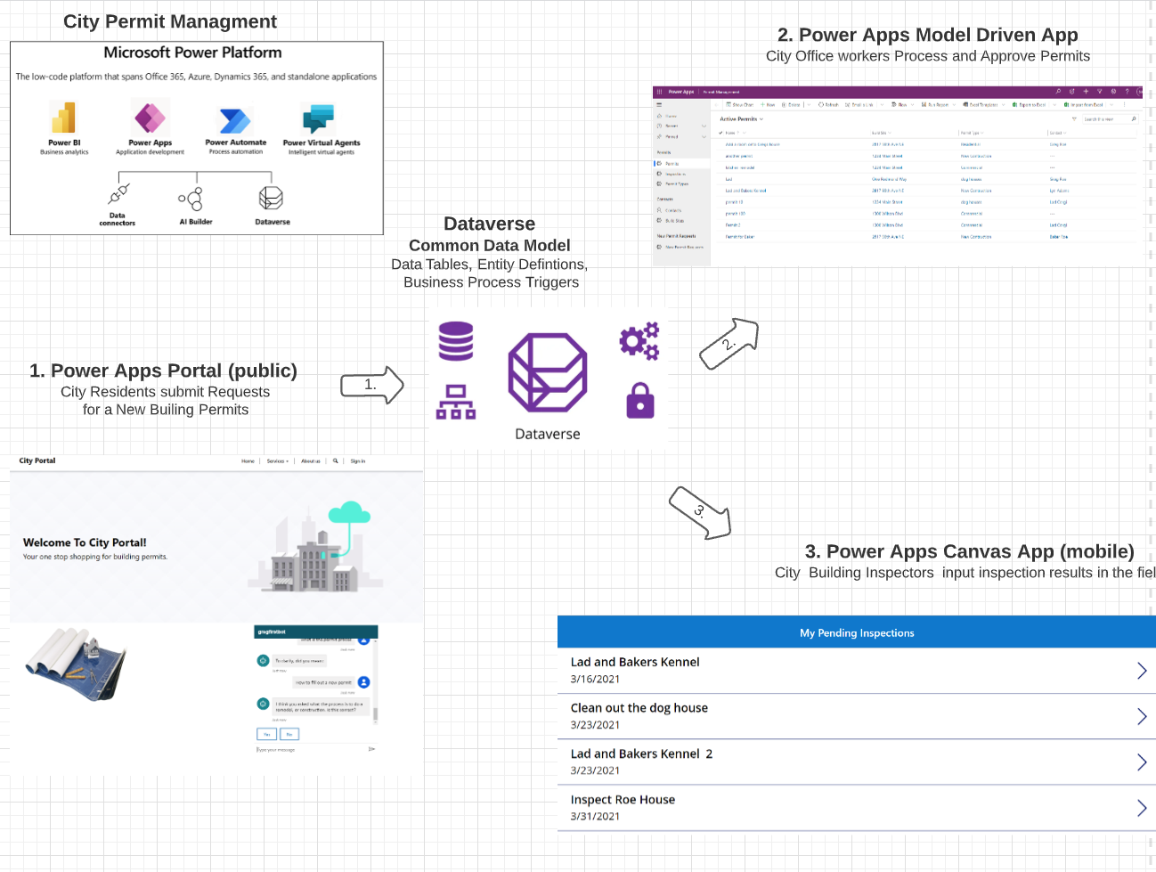

Slide 15
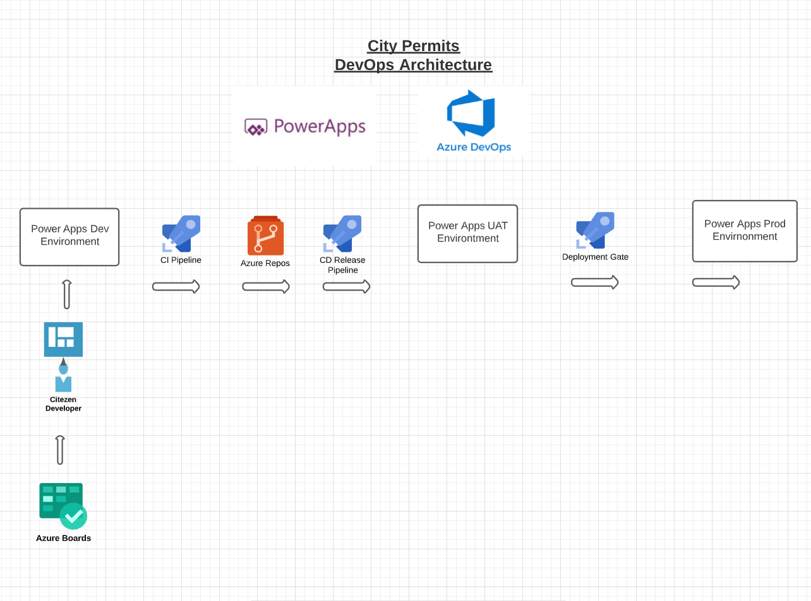

Slide 16
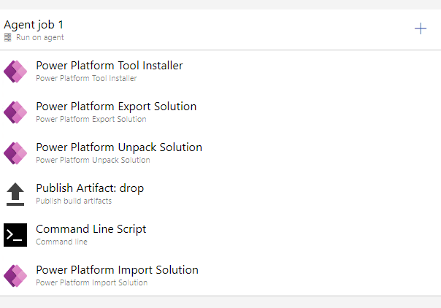
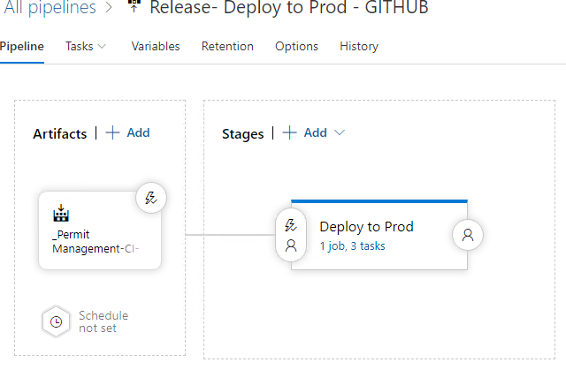
Azure DevOps Pipelines
CI(Integration) Pipeline
Release (Delivery) Pipeline
Power Platform URLs

Slide 17

DEMO: ContosoBicycles.com Devops with GitHub Actions
Demonstrates DevOps with GitHub Actions
Power Canvas Mobile Client App
.NET ASP Core Backends to Azure App Services Web app and Azure Kubernetes Service

Slide 18
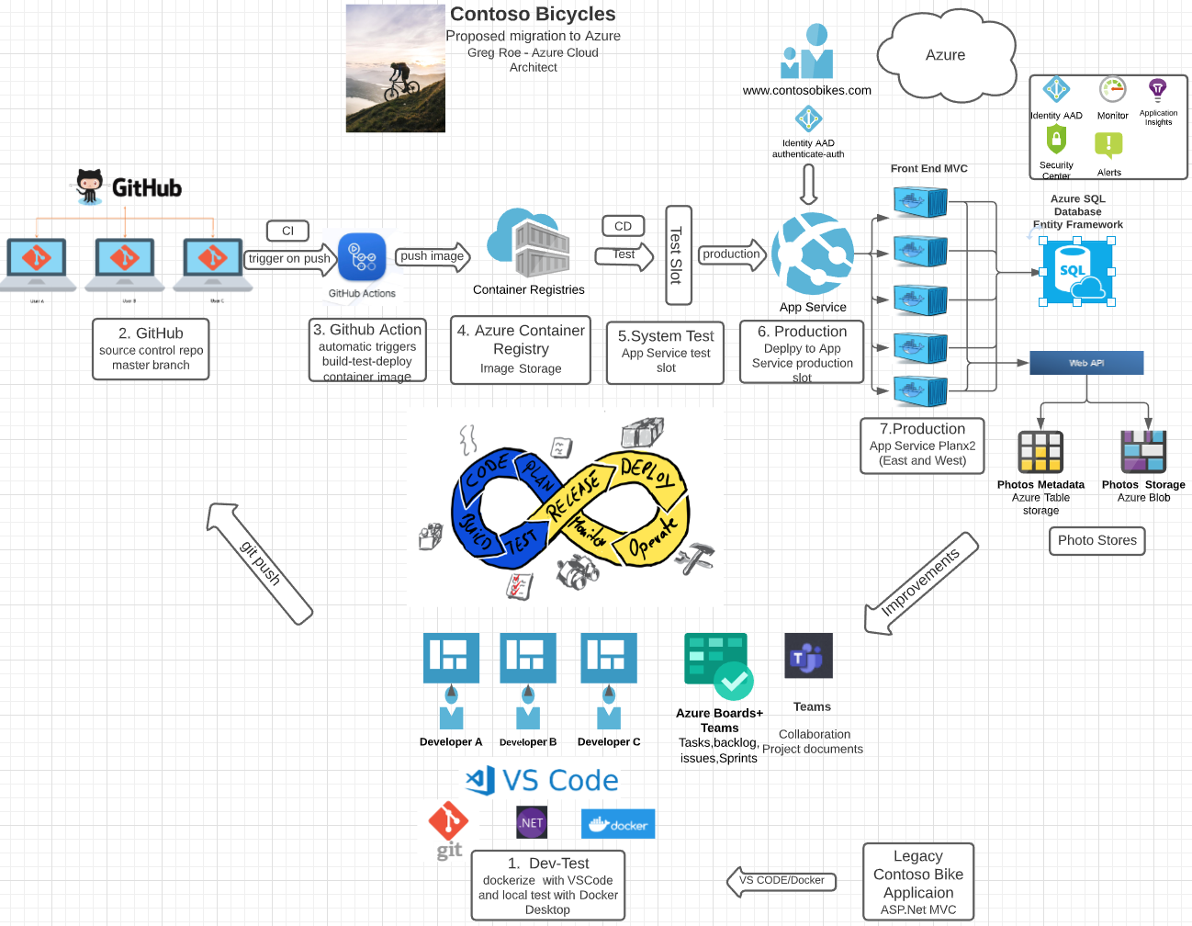

Slide 19
Demo: Diabetes Power Canvas App with Azure Machine Learning and Power Automate
Shows how to easily create a Power Canvas App client app that leverages Power Automate to get data from an Azure Machine Learning backend Service

Slide 20
Demo: Build Solution from Scratch. Manually Export from Dev , Import to Test
Create a new Solution
Create a new SQL based Canvas App
Create a new SharePoint base Canvas App
Add to the Solution
Export from Dev
Import to Test

Slide 21
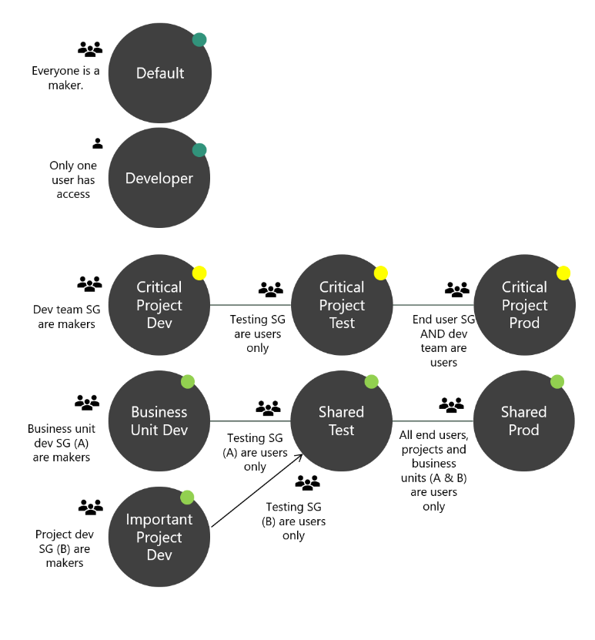
Developing an Environment Strategy
This can be organization wide if not already one in place
This can be project specific to support your team and project deployment
Notes:
Talk through Default and Developer – these typically won’t be in consideration for a project a Solution Architect is involved with. They will most likely be building using the critical project path of dev,test , production or dedicated dev and shared test/prod
https://docs.microsoft.com/en-us/power-platform/admin/environments-overview

Slide 22
Environment vs. source control master copy
Environment centric
The dev environment is the master copy of all changes
Changes promote directly from Dev -> Test->Prod
Source control centric
Source control is the master
Dev is re-created from source control (this can be automated and repeatable)
Changes from dev are checked into source control
Microsoft is encouraging and building tooling to support source control centric ALM
Notes:
Traditionally, Power Platform projects have been more environment centric and many are moving towards Source Control centric
Source control centric encourage having a definitive master and ability to re-create development environments for any version tracked
Ideally all environments other than production should be 'throw away' - that is they can be deleted and recreated without any loss

Slide 23
Solutions Overview
Solutions are a container to track the changes you make to the Common Data Service, Power Apps and Power Automate flows
Solutions are how you transport and install changes to target environments
Microsoft Dynamics 365 apps are installed using solutions
3rd party apps provided by Independent Software Vendors (ISVs) also use solutions
Development
Test
Production
Notes:
Solutions are containers that track and manage customizations in a CDS environment
If you have multiple environments, each would have their own set of solutions. Solutions can include entity metadata, forms, views, business rules, processes definitions and other assets required to run the app; including components created by developers like scripts or compiled code.
when you have a Dynamics 365 application like Sales or Service those are installed using the same solution framework. 3rd party ISVs also ship their products using solutions

Slide 24
Types of Solutions
Unmanaged
Managed
Used during development
Used to transport to other development environments
Used to distribute to non-development environments
Notes:
Unmanaged Solutions are to be used in development environments while you are making configuration changes to your application. Solutions are exported as unmanaged and checked into your source control system. Unmanaged solutions should be considered your source.
Managed solutions are used to deploy to any environment outside of development. This includes test, UAT, SIT, and production environments. Managed solutions should be generated by a build server and considered as a build artifact.

Slide 25
Solution Layering
Layering occurs on import of managed solutions
Layers describe the dependency chain of component from the root solution introducing it, through each solution that extends or changes the component’s behavior
Layers are created through extension of an existing component (taking a dependency on it) or through creation of a new component or version of a solution.
Application Behaviour
What the user sees
Unmanaged “layer”
Unmanaged Customizations
Unmanaged Solution C
Unmanaged Solution D
Managed Layers
1 per managed solution
Managed Solutions
Managed Solution B
Managed Solution A
System Layer* CDS Managed Layer
System Solution*
Base CDS entities

Slide 26
Solution Layering
Device Inventory App
Care Kudos App
What the apps and users see
Contoso Common
CDM Healthcare Extension
CDM/System Entities
Notes:
Solutions are layered. E.g. the contact form is customized in the CDM Healthcare Extension. The same form elements are modified in the Contoso Common solution. The end users will see the changes from the Contoso Common solution.

Slide 27
Defining the solution structure
One or more custom solutions should be created that contain the projects assets
Create a Solution Publisher and use for all solutions
Don’t use the default publisher or default solutions
Once defined, Solution Architect should communicate and ensure teams follow structure
Notes:
Generally it is always best to keep the solution structure as simple as possible

Slide 28
Deciding on one or more solutions
Use multiple solutions only for a tangible purpose, multiple solutions add complexity
Common patterns for multiple solution splitting is horizontal and vertical partitioning
Multiple solutions each require their own environments to ensure they remain independent
Care must be taken to manage dependencies
Teams must know what solution to put new components in

Slide 29
Example of Horizontal Solution Splitting
Visual Components
Processes & Plugins
Reports
Security Roles
Main
Apps
Canvas Components
PCF Components
Web Resources
Processes
Plug-in Assemblies
SDK Message Processing Steps
Reports
Security Roles
Entities
Option Sets
Client Extensions
Service Endpoints
Dashboards
Connection Roles
Article Templates
Email Templates
Mail Merge Templates
Field Security Profiles
Notes:
Can be all or some of these, but it should be for a purpose.
Care must be taken to ensure it doesn’t create a web of dependencies

Slide 30
Example of Vertical Layering
Contact: Track Specialized Relationships
Private Wealth Division
Greedy Insurance People Division
Retail Division
Contact: Track Basic Details
Really Large Bank, Inc.

Slide 31
Example of Vertical Layering
Specific Sports
Basketball
Baseball
…
Shared Base
Sports Management Base

Slide 32
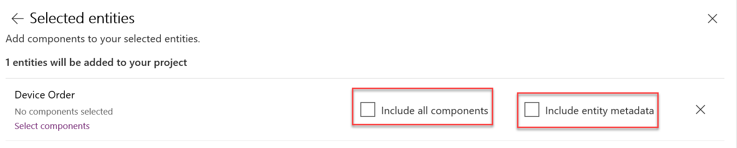
Include only the minimum components
Avoid using include all components unless adding in an unmanaged entity
Include entity metadata only when you are changing entity properties
Add subcomponents of entity (fields, forms, views etc.) only when you are changing them
Notes:
Often referred to as solution segmentation reduces the footprint of the solution to reduce change of collision as well as improves time to import/export. This also reduces unnecessary dependencies.
If too many entity sub components are included, you can remove the entity from the solution and re-add with only the minimal needed

Slide 33
Handling developer code assets
Solution aware developer code assets should be “built” on a build environment and not the developer's desktop
After built they should be deployed to an environment that the master solution will be exported from - or built into a solution that will be installed
Examples of code assets
Plug-ins
Form Script (could include TypeScript transpiling)
Power Apps Component Framework components
Notes:
Scripts should be bundled and minified

Slide 34
Non-solution/environment aware
ALM plan must consider how to handle these components of the overall project deliverables
Examples
Power BI visualizations
Microsoft Azure deployed components (e.g. Azure Function, ASP.net apps, etc.)
External integrated services

Slide 35
Handling configuration and reference data
Configuration Migration Tool can help move data between environments maintaining the primary record identifier
Solution Environment Variables can be used for application configuration data that can be environment specific

Slide 36
Environment Variables
Tracked as a solution component
Decimal, JSON, Text, and Two Options are supported data types
Can have a default value, and a current environment value
Apps, flows and developer code can retrieve and modify values if permissions allow
Environment Variable Definition
1:N
Environment Variable Value

Slide 37
Environment Variables Example
Development
Test
Production
Var – From Email
Var – From Email
Var – From Email
Value – dev@contoso.com
Value – test@contoso.com
Value – prod@contoso.com
Var – Auto Approve
Var – Auto Approve
Var – Auto Approve
Default – Yes
Default – Yes
Value – No
Notes:
This diagram illustrates how environment variables can be used to tailor values for each environment
Note that you can provide a default value that is used if a current value is not specified in a particular environment

Slide 38
Updating Existing Managed Solutions – Import Options
Update – Applies changes, no removal of items occur, can’t be used if any patches in place
Upgrade – Default option, imports changes and applies them immediately including removing components not in new solution, old solution and any patches are removed
Stage for Upgrade – Similar to upgrade but it pauses after new solution is imported before removing components so you can do data migration etc. and then manually trigger the final apply of the solution

Slide 39
App Builder workflow
Solution Architect should establish the workflow for how app builders will make changes and promote them
Communication and work assignment should be managed to minimize conflicts
Shared app building environments can be less complex but doesn’t offer isolation between app builders and lack detail tracking of changes
Individual app building environments offer isolation and tracking but require extra effort to merge work and resolve conflicts

Slide 40
Promoting to production
Solution Architect lead the effort to define the process for how changes will be promoted from dev to production
This includes defining the # of stages e.g. Dev - >Test -> Prod as well as the processes to do the promotion regardless if manual or automated
Microsoft is building tools to support doing this with Azure DevOps using continuous integration (CI) and continuous deployment (CD)

Slide 41
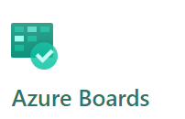
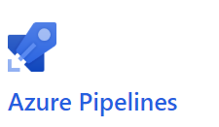
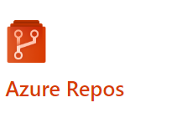
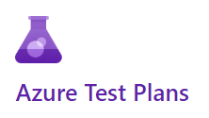
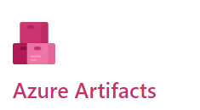
Azure Dev Ops
Notes:
Trainer- consider a demo here, many students have never done this before
Azure Boards - plan, track, and discuss work across your teams
Azure Pipelines – Use to automate CI/CD builds and releases
Azure Repos – Source Control to store and track changes
Azure Test Plans - Plan, execute, and track scripted tests
Azure Artifacts – publish solutions built by build pipelines

Slide 42
Using Azure Pipelines
Build pipelines can be used to
Create dev environments
Commit changes from dev to source control
Solution Checker
Automated Testing
To build output solutions from source control (e.g. managed/unmanaged)
Release pipelines can be used to
Take solutions from build pipelines and deploy them to one or more test/prod environments
Perform automated testing as part of release process
Pause for approvals before progressing to next environment

Slide 43



ALM Powered by Azure DevOps
Initiate
Build
Release
Getting started, faster
Build and Walk away
Automated, Predictive, Repeatable
Provision
Environment
Deploy
Dependencies
Pack Source
Code from
Repo
Import
Solution
Run Unit Test
Run Solution
Checker
Export
Solution
Unpack to
Repo
Run Unit Test
Pack Solution
Run Solution
Checker
Run
Integration
Test
Import as
unmanaged
Increment
Version
Export
Managed
Initial Build Pipeline instantiates pristine Development Environment daily
Build Pipeline Automates manual steps.
No more upload to Solution checker and
manually export solution, unpack and
push to repo
Automated Release Pipeline removes manual steps. Weekly, daily or hourly releases becomes the new standard
Powered by Azure DevOps
Notes:
This would be a good place for the instructor to show in Azure Dev Ops the tasks and talk through them

Slide 44
Alternative automation tools
CDS and Admin APIs can be used to automate from any supported language
Direct PowerShell can be used instead of build tasks for more control
Power Automate can also be used with the platform admin connectors to automate deployments
Power Platform CLI

Slide 45
Power Platform CLI
Microsoft Power Platform CLI is a simple, one-stop (developer/IT) Command line interface to help automate Common Administrative tasks Command Description Admin Commands for environment lifecycle features. Auth Commands to authenticate to Dataverse. Canvas Commands for working with canvas app source files. Org Commands for working with Dataverse environments. Package Commands for working with solution packages. Paportal Commands for working with Power Apps portals (Preview). PCF Commands for working with Power Apps component framework. Plugin Command to create a plug-in project. Solution Commands for working with Dataverse solution projects. Telemetry Manages the telemetry settings.

Slide 46
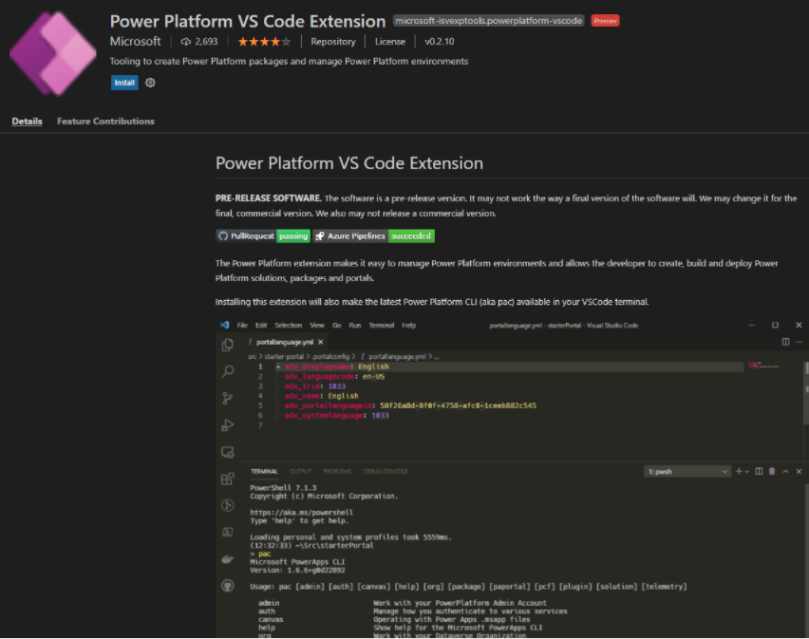
Power Platform VS Code Extension

Slide 47
Demo: Use PAC CLI to automate the Export from Dev / Import to Test
Automate Export and Import of previous solution by using the PAC CLI

Slide 48
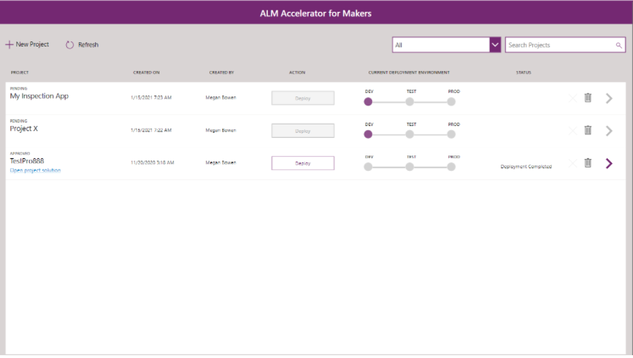
ALM Accelerator for Makers App
Part of the Microsoft Power Platform Center Of Excellence Toolkit
Create Simplified DevOps workflows. Get Started here
Power CAT Video: ALM Made Easy
Salient points:
ALM is about adding more rigor and discipline as the app and team grows in complexity. To ensure quality
Build and Deployment Automation
Needed in Low Code as well as traditional Pro Code
Solutions moved from Dev-Test-Prod Environments
COE Starter Kit helps makes Devops easier for the Power Platform
ALM Accelerator abstracts the Source Checked, Automation, and provides a Workflow Approval Process for moving application solutions from Dev-Test-Prod

Slide 49
Demo: ALM Accelerator for Makers App

Slide 50
Deployment Checklist
Proper environment access has been established e.g. Security Groups
Data loss prevention policies are correct for solution environments
Service Principals and service accounts necessary for connections are in place and configured after initial deploy
Environment settings have been documented and configured in each environment

Slide 51
Wrapping up
Establishing application lifecycle management process should be done at the start of the project
Having a repeatable process saves time and ensures consistent results
ALM is not a one size fits all, you must size it to fit your project

Slide 52
Hands on exercise: Application Lifecycle Management
Solution Architect series: Plan application lifecycle management for Power Platform - Learn | Microsoft Docs

Slide 53
Resources
PL-600 Power Platform Solutions Architect Certification and Labs
Docs -- Application lifecycle management (ALM) with Microsoft Power Platform
MSLearn -- Plan ALM for Power Platform
List of Power Platform Certifications
MSLearn -- All Power Platform Learning Paths (self guided training)
What is DevOps?
Developing an Environment Strategy
Solutions Overview
Environment Variables
Power Apps Service URLS

